Slide 1

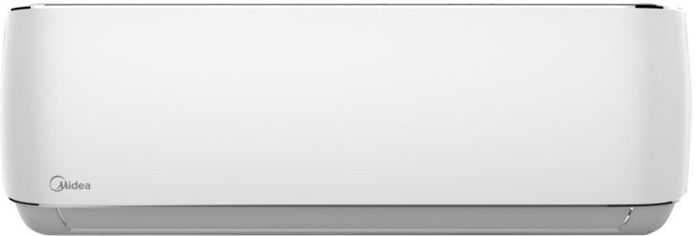
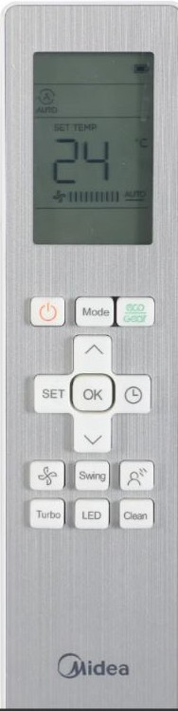
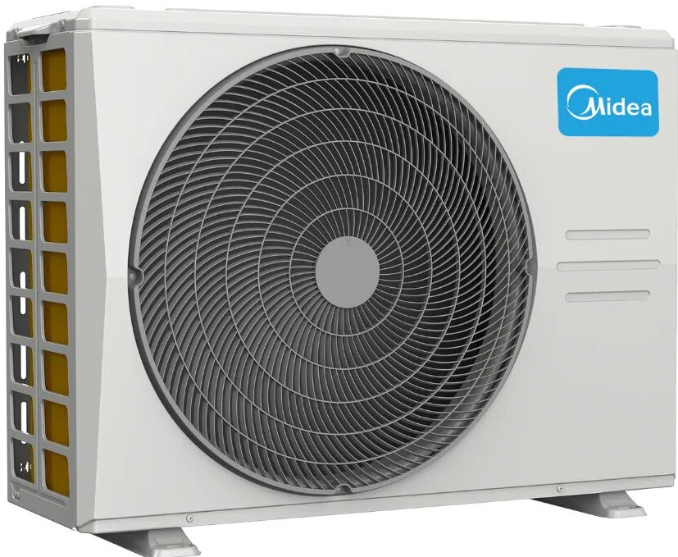
Aurora Series
Cooling: 9.0 kW
Heating: 10.0 kW
Installation Included
Advanced DC inverter technology
Low noise operation
Built-in Wi-Fi
4-star energy rating

